Slide 1

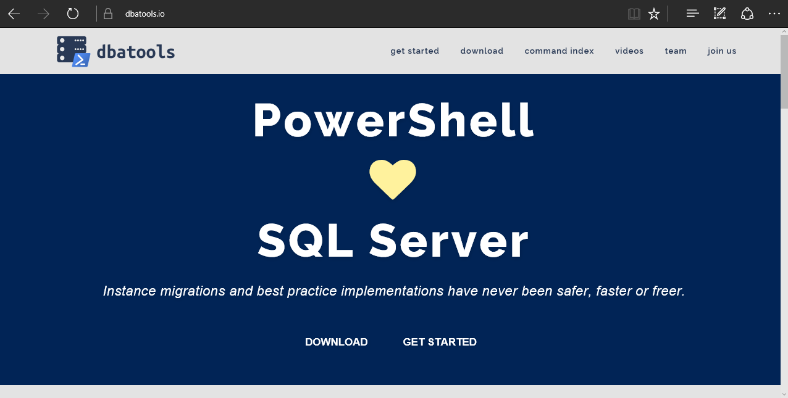
dbatools
chrissy lemaire, mvp: netnerds.net, @cl code: dbatools.io
Notes:
Community project, initially started out as Start-SqlMigration but has grown into a DBA’s best friend. dbatools currently sports 79 commands.
How many of you have heard of dbatools? How many of you have used it? How many knew it was born in Belgium? :D

Slide 2
System Requirements
Minimum
Client
PowerShell v3
SQL Server Management Studio 2008 R2
Server
SQL Server 2000
Recommended
Client
PowerShell v5
SQL Server Management Studio 2012+
Server
SQL Server 2005+
chrissy lemaire, mvp: netnerds.net, @cl code: dbatools.io
Notes:
Started as a migration tool, so I strived to support older environments
No reliance on SQLPS, because we’ve got a history ;)

Slide 3
Install is easy
PowerShell Gallery
Install-Module dbatools
GitHub – dbatools.io/git
Clone repo found at dbatools.io/git, Import-Module dbatools
Invoke-Expression (Invoke-WebRequest https://git.io/vn1hQ)
chrissy lemaire, mvp: netnerds.net, @cl code: dbatools.io
Notes:
Gallery requires admin access and is built into PowerShell v5. Other versions also support it with a bit of configuration.
Download
Unzip
Import-Module

Slide 4
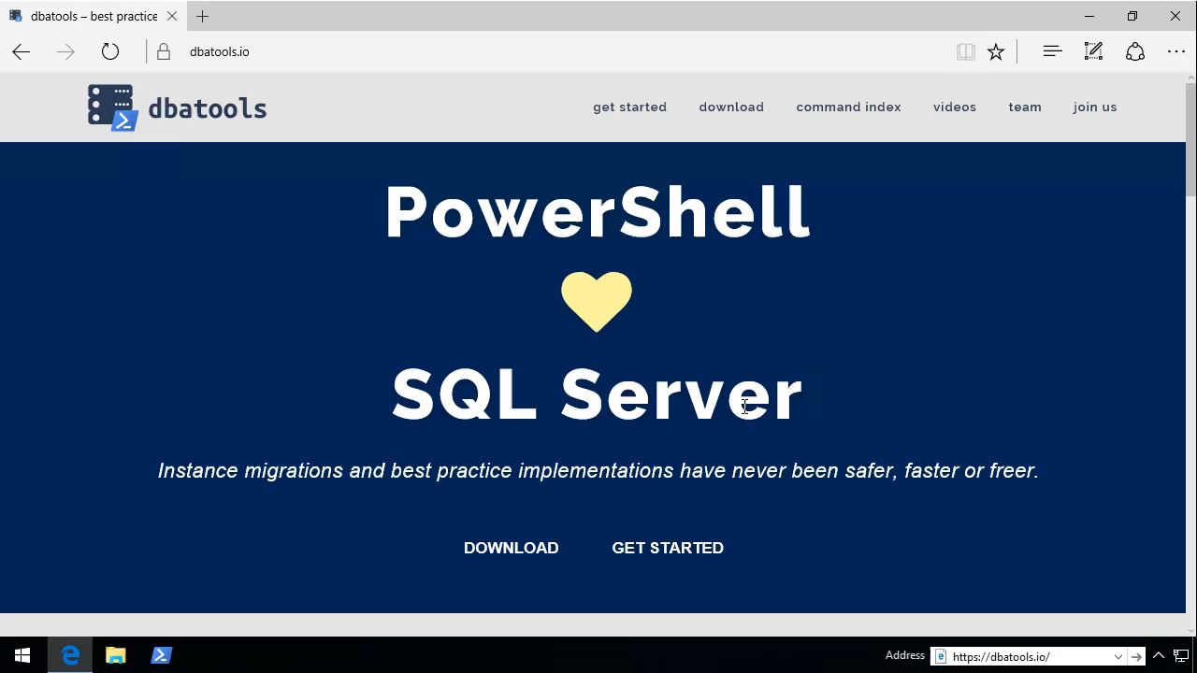
See?
chrissy lemaire, mvp: netnerds.net, @cl code: dbatools.io

Slide 5
Support
SQL Server 2000 – 2016
Express – Datacenter Edition
Clustered and stand-alone instances
Windows and SQL authentication
Default and named instances
Multiple instances on one server
Auto-populated parameters for command-line completion (think -Databases and -Logins)
chrissy lemaire, mvp: netnerds.net, @cl code: dbatools.io

Slide 6
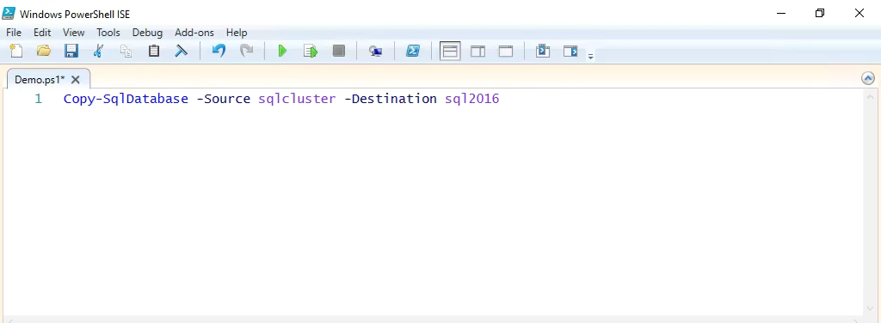
Support
chrissy lemaire, mvp: netnerds.net, @cl code: dbatools.io

Slide 7
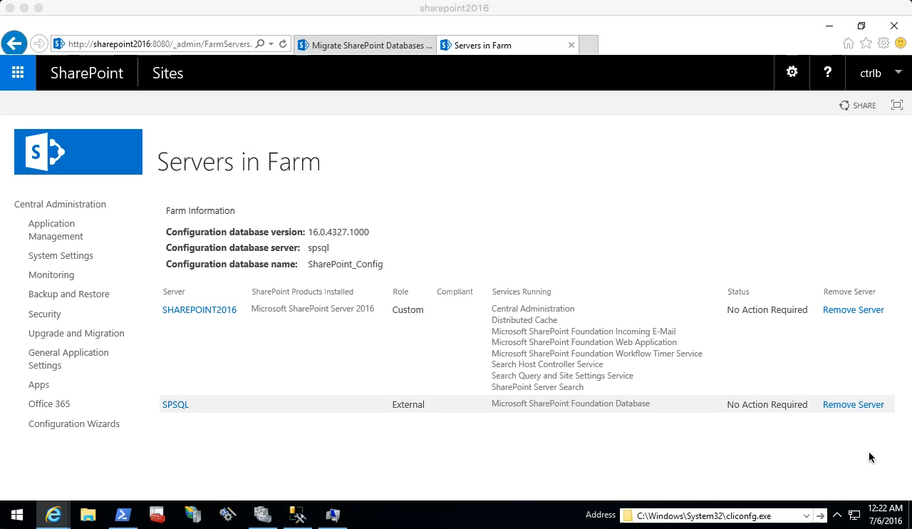
Start-SqlMigration
chrissy lemaire, mvp: netnerds.net, @cl code: dbatools.io

Slide 8

Start-SqlMigration
chrissy lemaire, mvp: netnerds.net, @cl code: dbatools.io

Slide 9

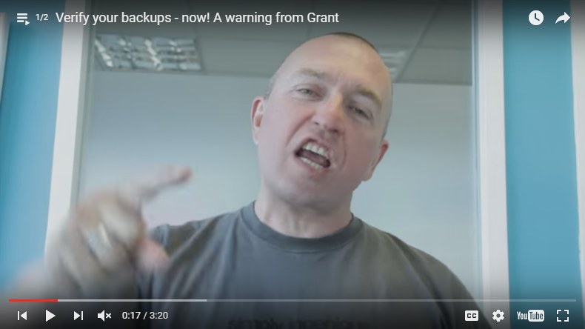
Remove-SqlDatabaseSafely
Grant Fritchey
chrissy lemaire, mvp: netnerds.net, @cl code: dbatools.io
Notes:
Grant Fritchy is a pretty smart guy

Slide 10
Remove-SqlDatabaseSafely
Performs a DBCC CHECKDB
Backs up the database WITH CHECKSUM
Restores with VERIFY ONLY on the source
Creates and Agent job to easily restore from that backup
Drops the database
The Agent Job restores the database
Performs a DBCC CHECKDB
Drops the database for a final time
chrissy lemaire, mvp: netnerds.net, @cl code: dbatools.io
Notes:
Remove-SqlDatabaseSafely addresses the issue that we all face – “hey can you drop that database?” “oh no! can you put it back?”

Slide 11
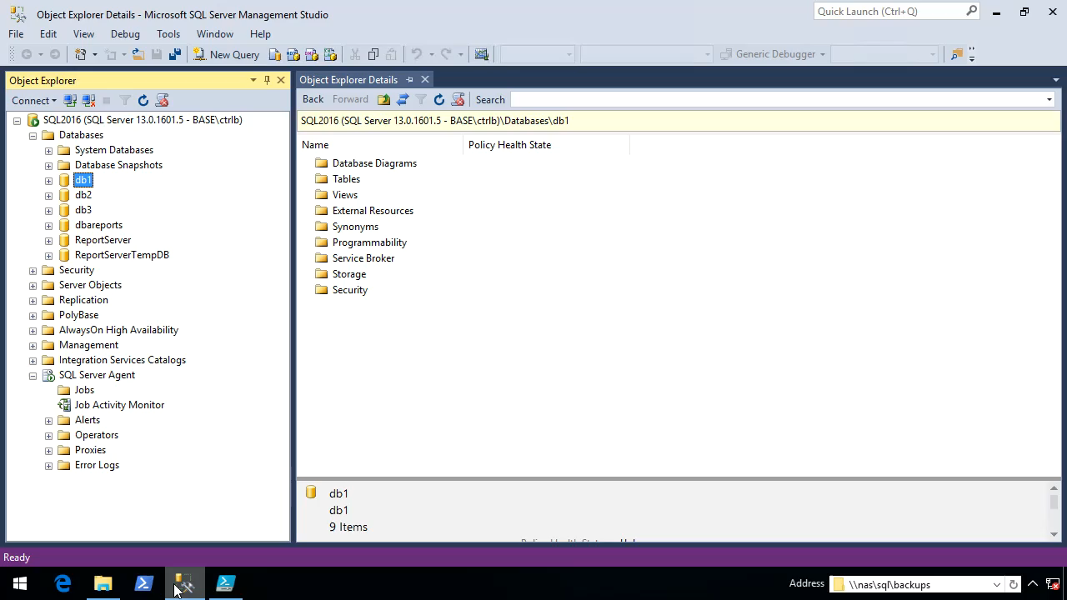
Remove-SqlDatabaseSafely
chrissy lemaire, mvp: netnerds.net, @cl code: dbatools.io

Slide 12
Remove-SqlDatabaseSafely
chrissy lemaire, mvp: netnerds.net, @cl code: dbatools.io

Slide 13
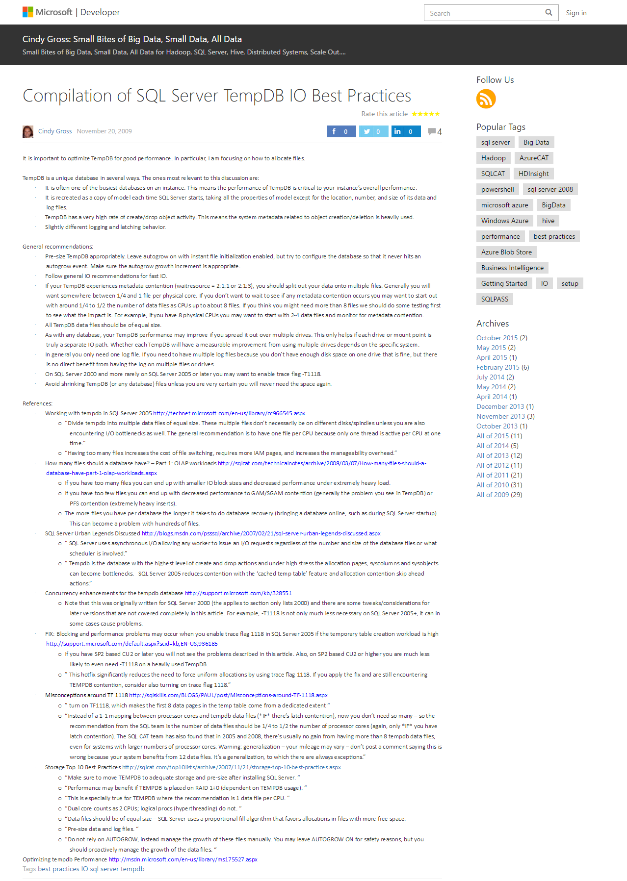
Test-SqlTempDbConfiguration
chrissy lemaire, mvp: netnerds.net, @cl code: dbatools.io

Slide 14
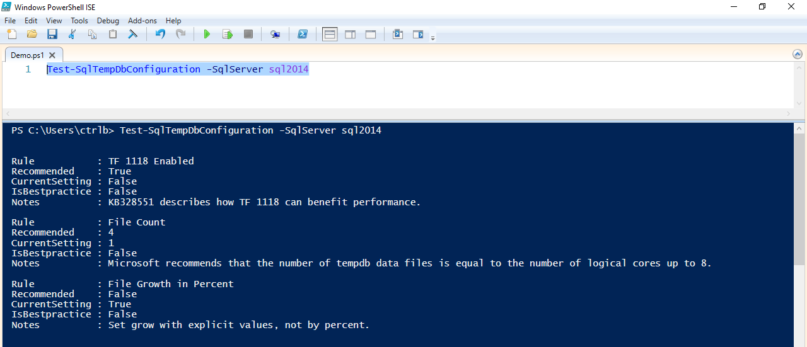
Test-SqlTempDbConfiguration
chrissy lemaire, mvp: netnerds.net, @cl code: dbatools.io

Slide 15
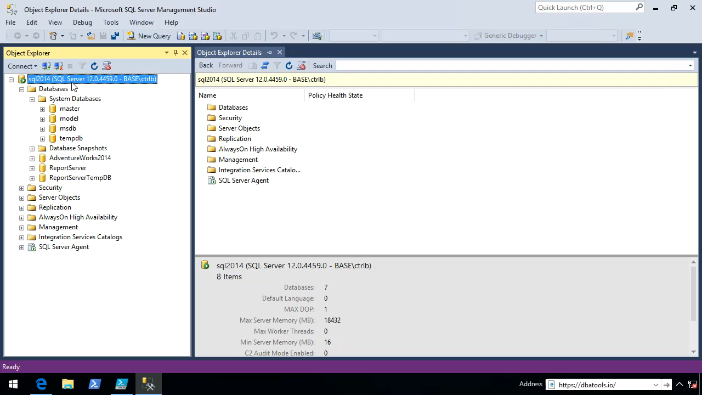
Set-SqlTempDbConfiguration
chrissy lemaire, mvp: netnerds.net, @cl code: dbatools.io

Slide 16
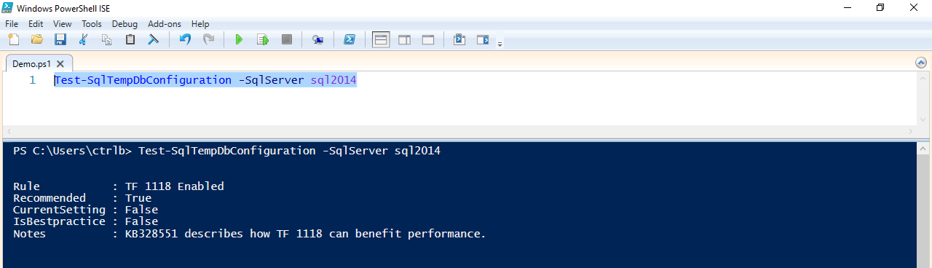
Test-SqlTempDbConfiguration
chrissy lemaire, mvp: netnerds.net, @cl code: dbatools.io

Slide 17
Find-SqlDuplicateIndex
WITH CTE_IndexCols AS ( SELECT i.[object_id] ,i.index_id ,OBJECT_SCHEMA_NAME(i.[object_id]) AS SchemaName ,OBJECT_NAME(i.[object_id]) AS TableName,Name AS IndexName,ISNULL(STUFF((SELECT ', ' + col.NAME + ' ' + CASE WHEN idxCol.is_descending_key = 1 THEN 'DESC' ELSE 'ASC' END FROM sys.index_columns idxCol INNER JOIN sys.columns col ON idxCol.[object_id] = col.[object_id] AND idxCol.column_id = col.column_id WHERE i.[object_id] = idxCol.[object_id] AND i.index_id = idxCol.index_id AND idxCol.is_included_column = 0 ORDER BY idxCol.key_ordinal FOR XML PATH('')), 1, 2, ''), '') AS KeyCols,ISNULL(STUFF((SELECT ', ' + col.NAME + ' ' + CASE WHEN idxCol.is_descending_key = 1 THEN 'DESC' ELSE 'ASC' END FROM sys.index_columns idxCol INNER JOIN sys.columns col ON idxCol.[object_id] = col.[object_id] AND idxCol.column_id = col.column_id WHERE i.[object_id] = idxCol.[object_id] AND i.index_id = idxCol.index_id AND idxCol.is_included_column = 1 ORDER BY idxCol.key_ordinal FOR XML PATH('')), 1, 2, ''), '') AS IncludedCols ,i.[type_desc] AS IndexType ,i.is_disabled AS IsDisabled ,i.has_filter AS IsFiltered FROM sys.indexes AS i WHERE i.index_id > 0 AND i.[type_desc] IN ('CLUSTERED', 'NONCLUSTERED') AND OBJECT_SCHEMA_NAME(i.[object_id]) <> 'sys' ), CTE_IndexSpace AS ( SELECT s.[object_id] ,s.index_id ,SUM(s.[used_page_count]) * 8 / 1024.0 AS IndexSizeMB ,SUM(p.[rows]) AS NumberRows ,p.data_compression_desc AS CompressionDesc FROM sys.dm_db_partition_stats AS s INNER JOIN sys.partitions p WITH (NOLOCK) ON s.[partition_id] = p.[partition_id] AND s.[object_id] = p.[object_id] AND s.index_id = p.index_id WHERE s.index_id > 0 AND OBJECT_SCHEMA_NAME(s.[object_id]) <> 'sys' GROUP BY s.[object_id], s.index_id, p.data_compression_desc ) SELECT DB_NAME() AS DatabaseName ,CI1.SchemaName + '.' + CI1.TableName AS 'TableName' ,CI1.IndexName ,CI1.KeyCols ,CI1.IncludedCols ,CI1.IndexType ,CSPC.IndexSizeMB ,CSPC.CompressionDesc ,CSPC.NumberRows ,CI1.IsDisabled ,CI1.IsFiltered FROM CTE_IndexCols AS CI1 INNER JOIN CTE_IndexSpace AS CSPC ON CI1.[object_id] = CSPC.[object_id] AND CI1.index_id = CSPC.index_id WHERE EXISTS (SELECT 1 FROM CTE_IndexCols CI2 WHERE CI1.SchemaName = CI2.SchemaName AND CI1.TableName = CI2.TableName AND CI1.KeyCols = CI2.KeyCols AND CI1.IncludedCols = CI2.IncludedCols AND CI1.IsFiltered = CI2.IsFiltered AND CI1.IndexName <> CI2.IndexName )
chrissy lemaire, mvp: netnerds.net, @cl code: dbatools.io
Notes:
Who remembers the query for finding duplicate indexes for SQL Server 2008 and above?

Slide 18
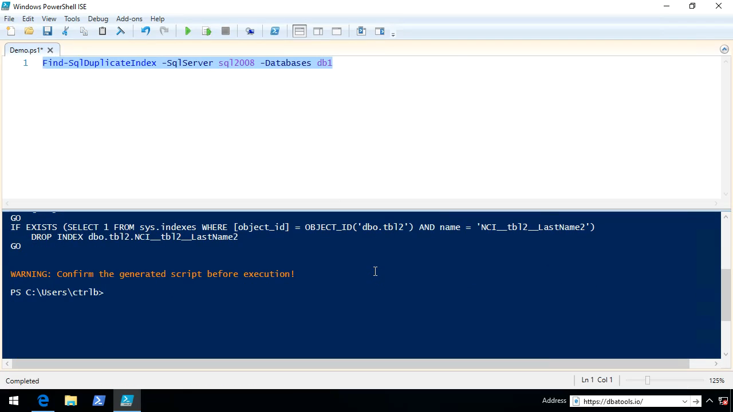
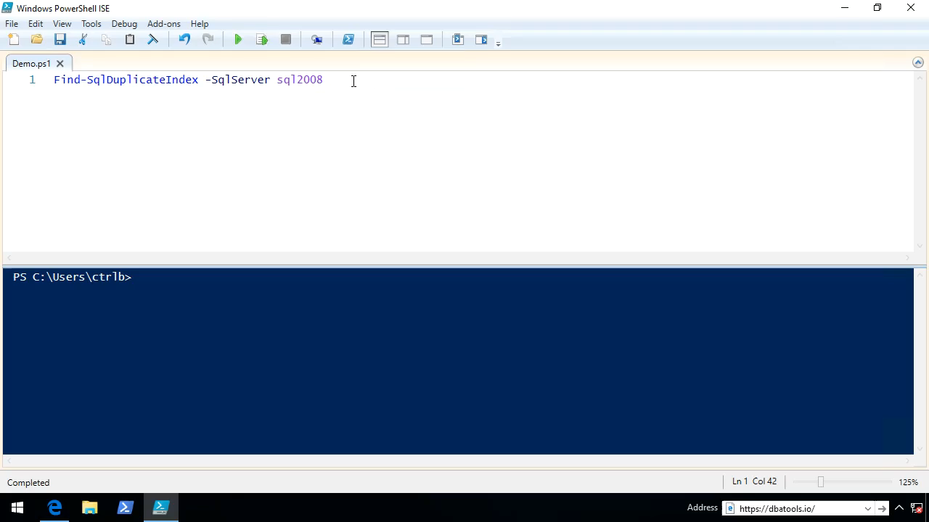
Find-SqlDuplicateIndex
chrissy lemaire, mvp: netnerds.net, @cl code: dbatools.io
Notes:
Who remembers the query for finding duplicate indexes for SQL Server 2008 and above?

Slide 19


Show-SqlWhoIsActive
Adam Machanic
chrissy lemaire, mvp: netnerds.net, @cl code: dbatools.io

Slide 20
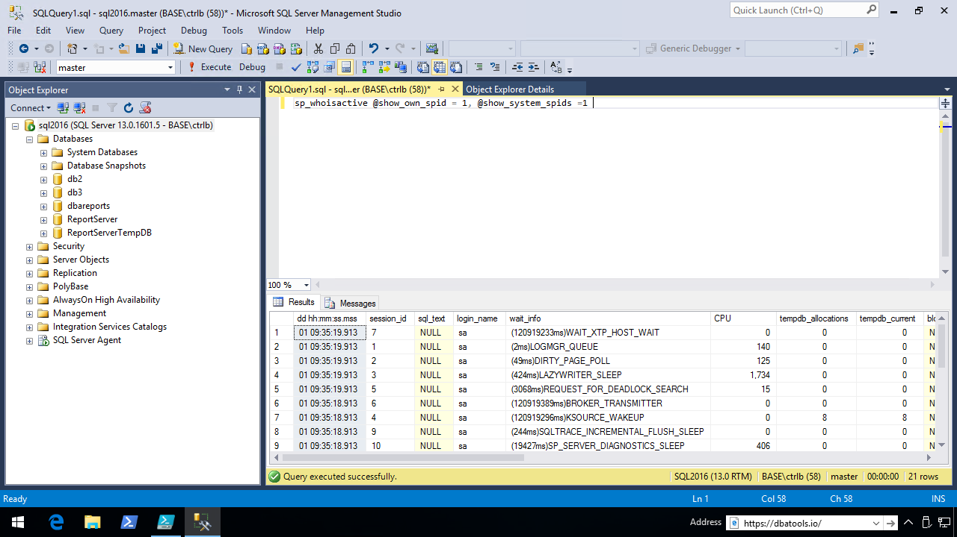
Show-SqlWhoIsActive
chrissy lemaire, mvp: netnerds.net, @cl code: dbatools.io

Slide 21
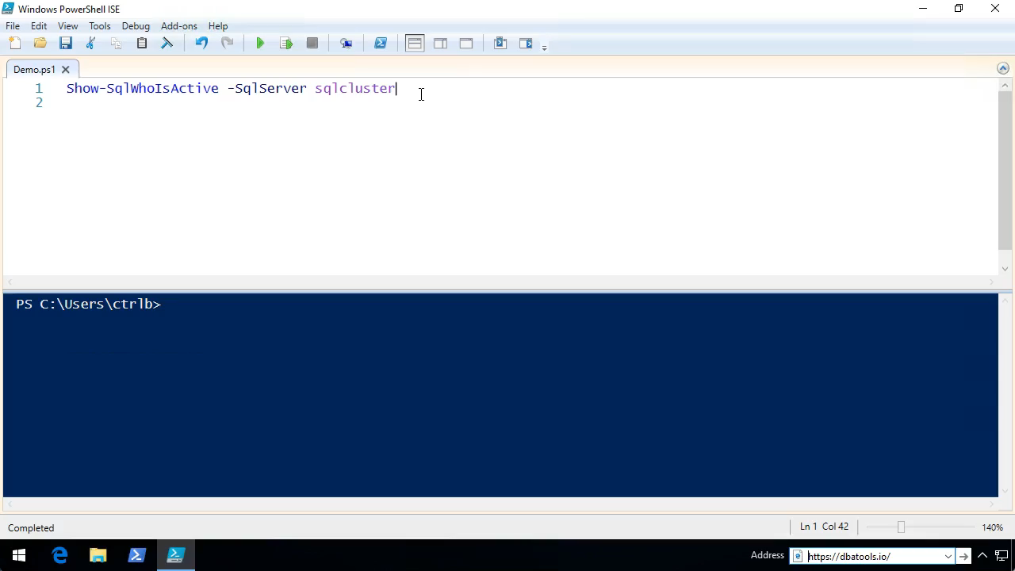
Show-SqlWhoIsActive
chrissy lemaire, mvp: netnerds.net, @cl code: dbatools.io

Slide 22
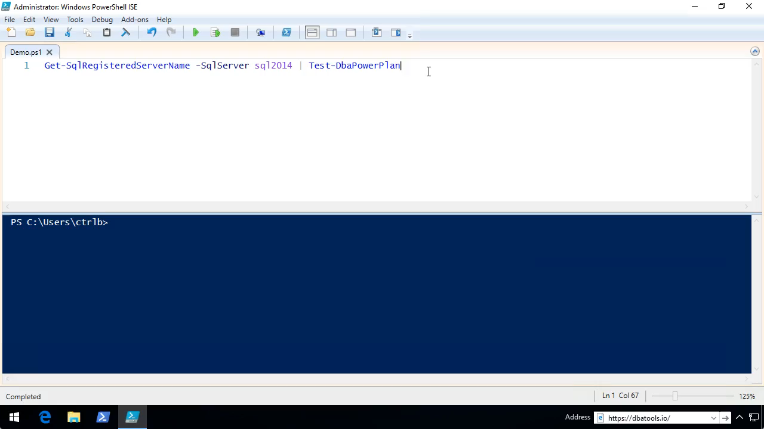
Test-DbaPowerPlan
chrissy lemaire, mvp: netnerds.net, @cl code: dbatools.io

Slide 23
Repair-SqlOrphanUser
USE db1
GO
EXEC sp_change_users_login 'Auto_Fix', 'db1user'
chrissy lemaire, mvp: netnerds.net, @cl code: dbatools.io

Slide 24
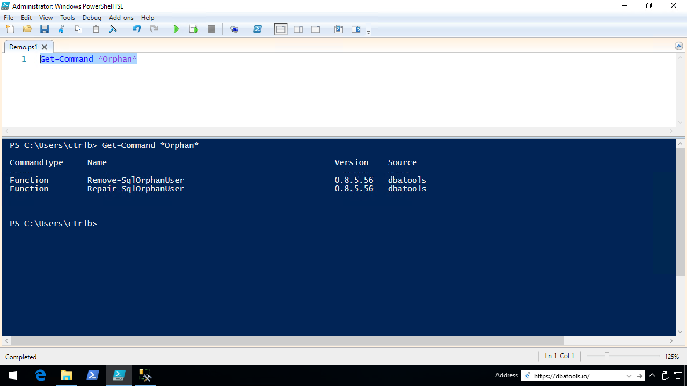
Repair-SqlOrphanUser
chrissy lemaire, mvp: netnerds.net, @cl code: dbatools.io

Slide 25
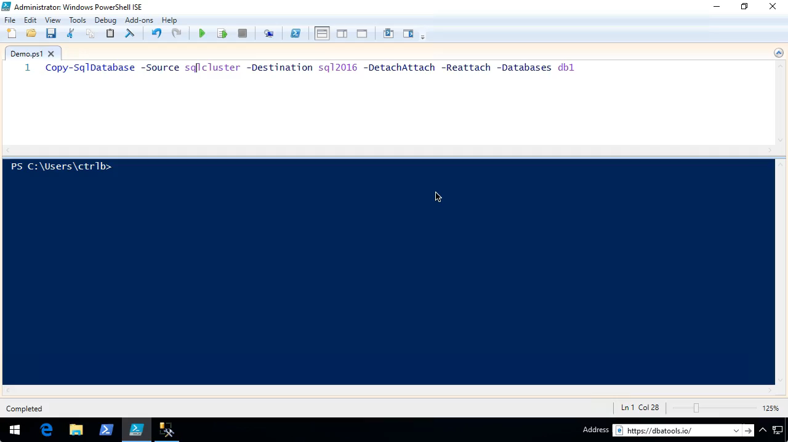
Repair-SqlOrphanUser
chrissy lemaire, mvp: netnerds.net, @cl code: dbatools.io

Slide 26
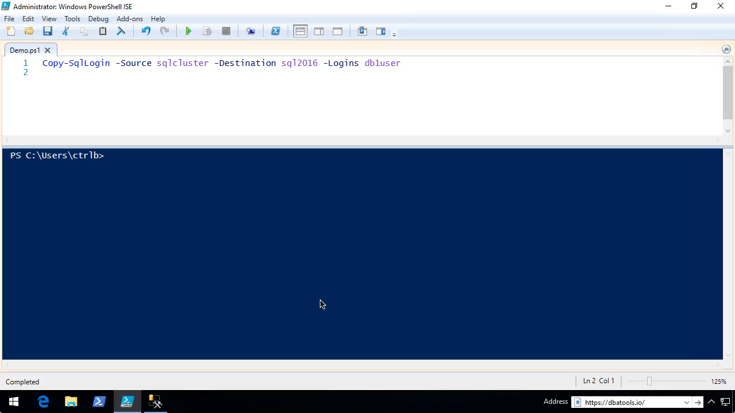
Copy-SqlLogin
chrissy lemaire, mvp: netnerds.net, @cl code: dbatools.io
Notes:
But really you should be using…

Slide 27
Reset-SqlAdmin
Service is restarted with /mReset-SqlAdmin parameter
Login is added if it doesn't exist
Login is enabled
Login is added to sysadmin role
If login is a Windows User an attempt is made to ensure the account exists
If login is a SQL Login: A secure password prompt will appear Password policy is set to off SQL Server authentication is set to Mixed Mode Login is unlocked
Service is restarted normally
chrissy lemaire, mvp: netnerds.net, @cl code: dbatools.io
Notes:
]

Slide 28
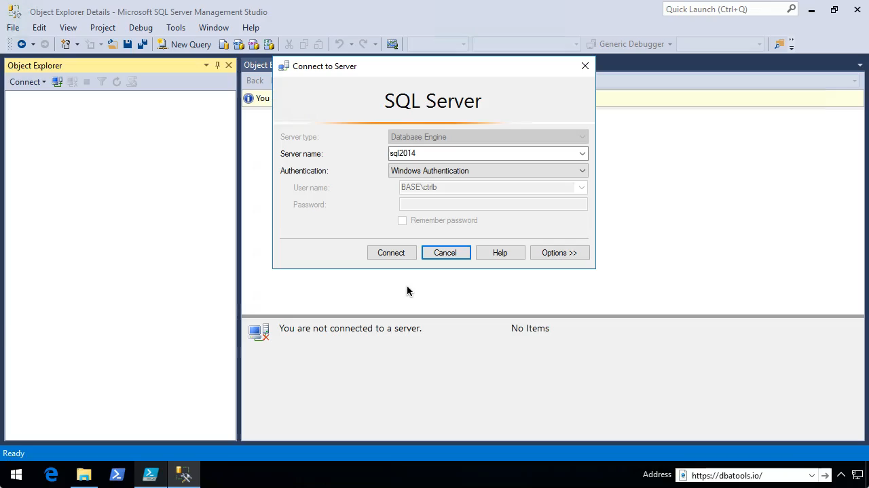
Reset-SqlAdmin
chrissy lemaire, mvp: netnerds.net, @cl code: dbatools.io

Slide 29
Reset-SqlAdmin
chrissy lemaire, mvp: netnerds.net, @cl code: dbatools.io

Slide 30
How to Get-Help
Extensive documentation within each command Get-Help Start-SqlMigration –Detailed
Extensive documentation on dbatools.io
dbatools.io/Start-SqlMigration
dbatools.io/Repair-SqlOrphanUser
Some commands have videos
dbatools.io/youtube
chrissy lemaire, mvp: netnerds.net, @cl code: dbatools.io

Slide 31
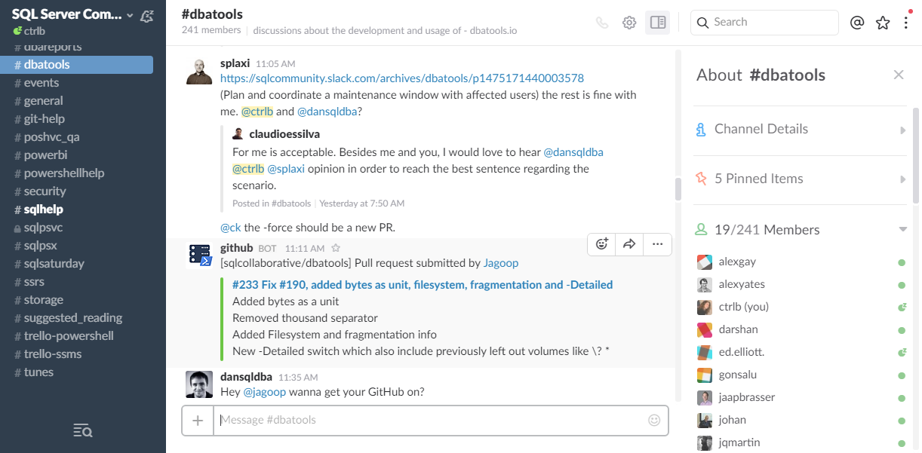
Join us! - dbatools.io/slack
chrissy lemaire, mvp: netnerds.net, @cl code: dbatools.io

Slide 32
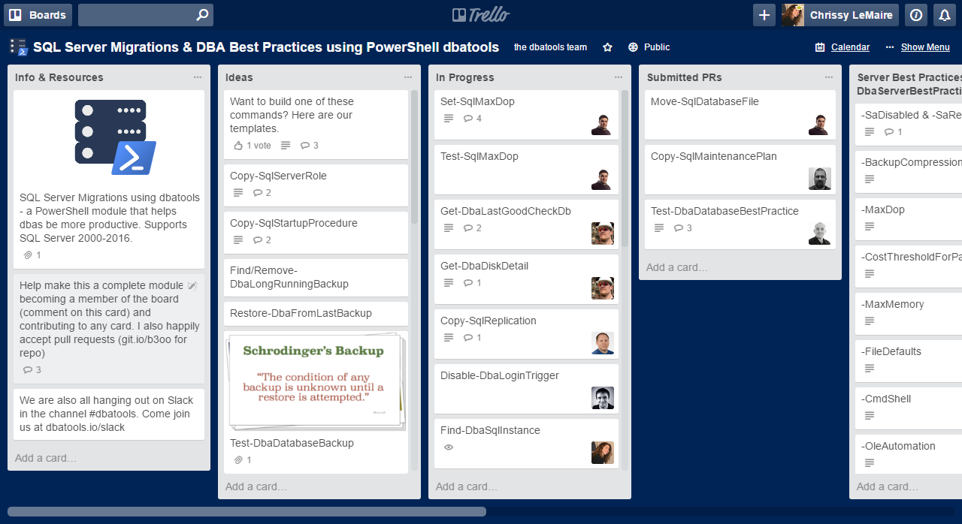
Join us! - dbatools.io/trello
chrissy lemaire, mvp: netnerds.net, @cl code: dbatools.io

Slide 33
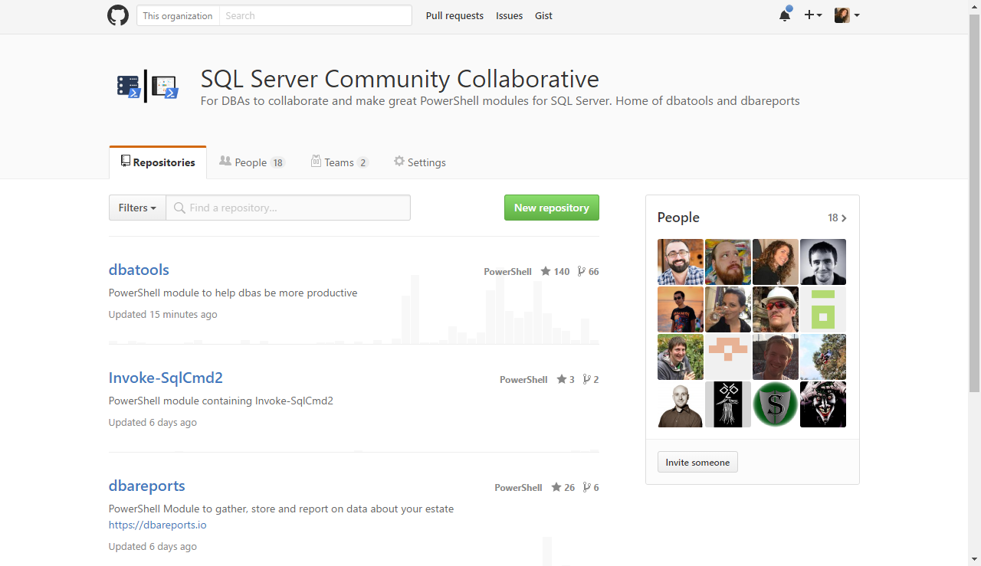
Join us! - dbatools.io/git
chrissy lemaire, mvp: netnerds.net, @cl code: dbatools.io

Slide 34
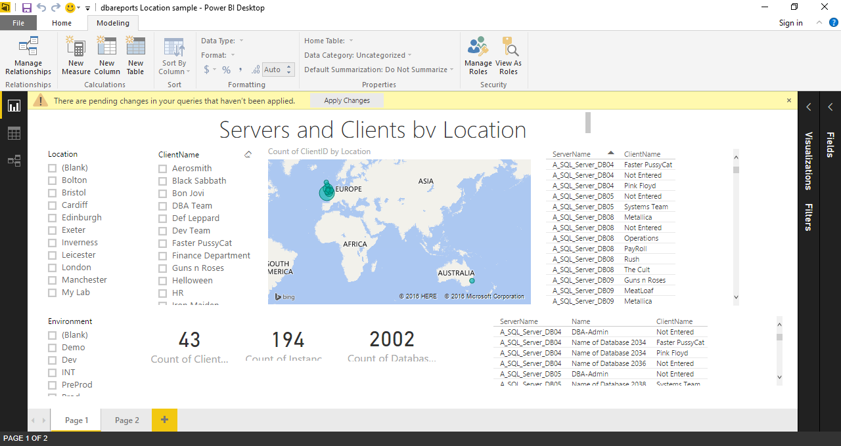
dbareports.io
chrissy lemaire, mvp: netnerds.net, @cl code: dbatools.io

Slide 35


dbareports.io
Rob Sewell
chrissy lemaire, mvp: netnerds.net, @cl code: dbatools.io

Slide 36
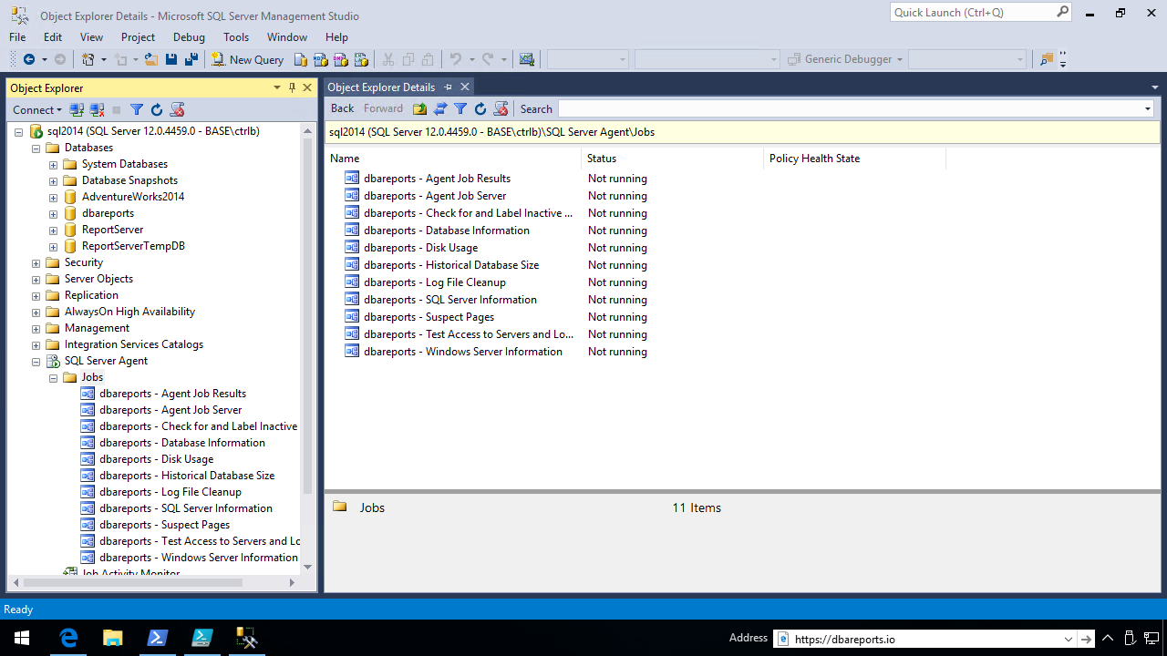
dbareports.io
chrissy lemaire, mvp: netnerds.net, @cl code: dbatools.io

Slide 37
dbareports.io – Install-DbaReports auto-installer
If script and log locations aren’t specified – uses backup directory
Creates database
Prompts to create proxy account
Installs or upgrades all database objects
Creates SQL agent jobs
Schedules jobs
Creates SQL Server alias
Creates client config file
Copies same reports shortcut to Desktop
Prompts to add host SQL Server to inventory
chrissy lemaire, mvp: netnerds.net, @cl code: dbatools.io

Slide 38
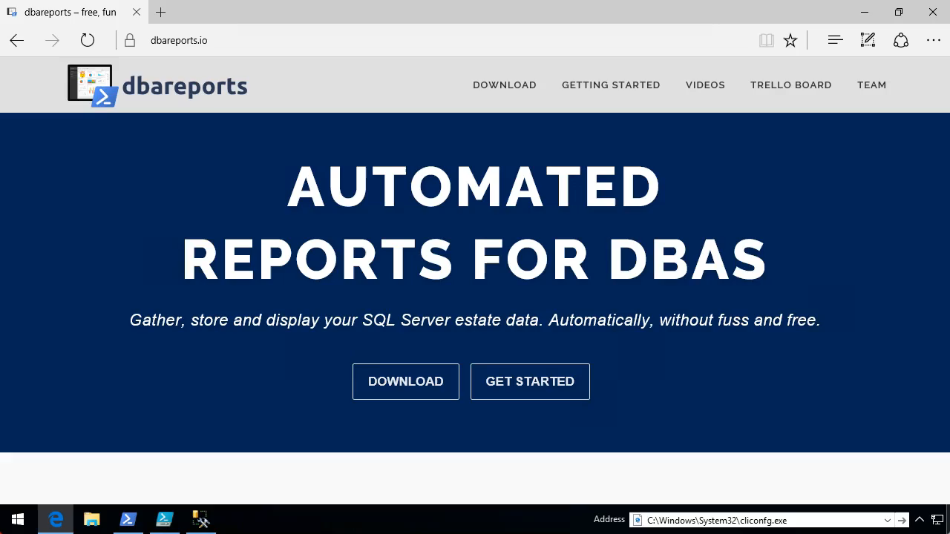
dbareports.io – Install-DbaReports auto-installer
chrissy lemaire, mvp: netnerds.net, @cl code: dbatools.io

Slide 39
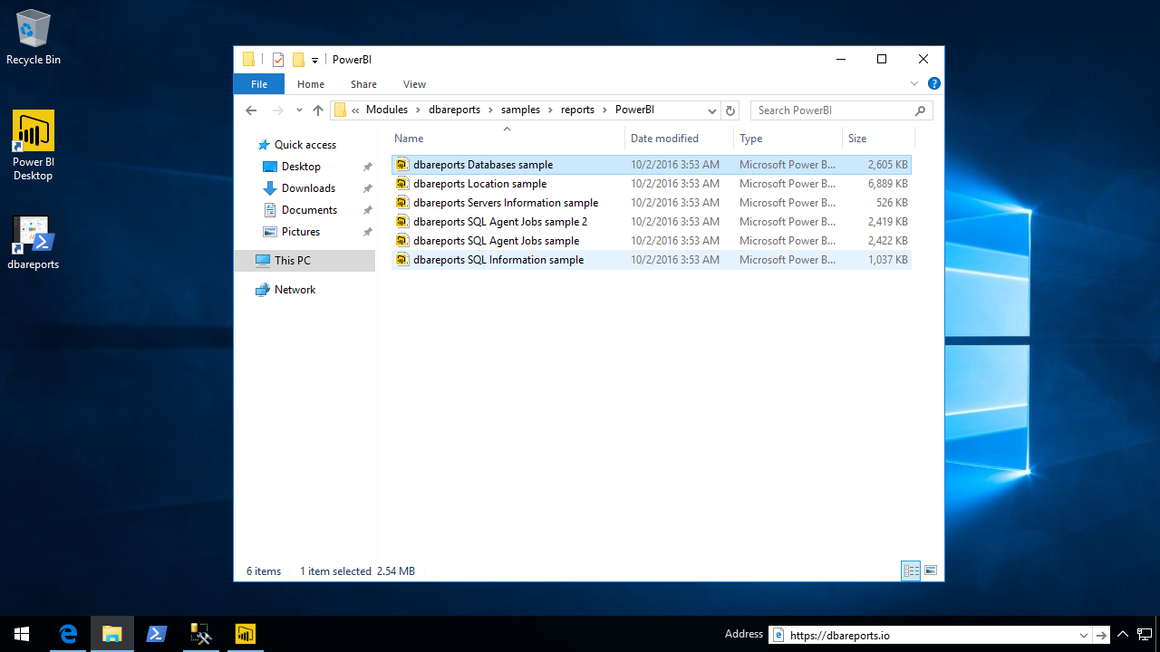
dbareports.io
chrissy lemaire, mvp: netnerds.net, @cl code: dbatools.io

Slide 40
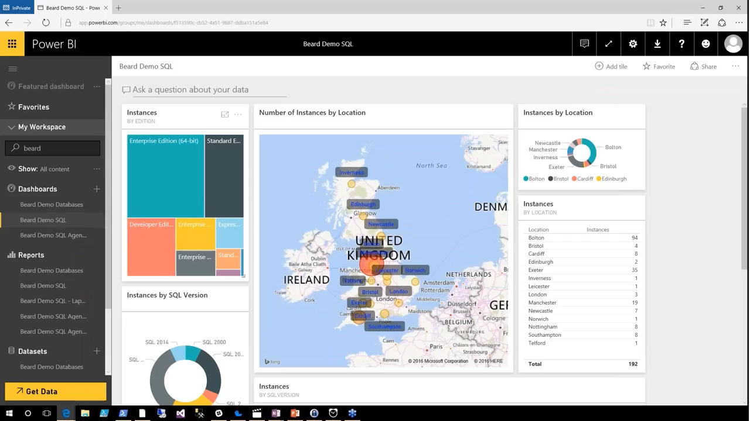
dbareports.io
chrissy lemaire, mvp: netnerds.net, @cl code: dbatools.io
Notes:
Cut it out.

Slide 41

Community got me feelin’ like
chrissy lemaire, mvp: netnerds.net, @cl code: dbatools.io
Notes:
Cut it out.

Slide 42
Review
PowerShell is a DBA’s best friend Migrations Best Practices Reporting
Join us! dbatools.io/slack dbatools.io/git dbatools.io/twitter dbatools.io/youtube
chrissy lemaire, mvp: netnerds.net, @cl code: dbatools.io

Slide 43


Thank you!
chrissy lemaire, mvp: netnerds.net, @cl code: dbatools.io

